Slide 1

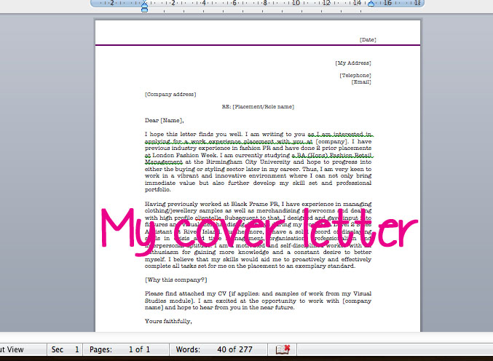




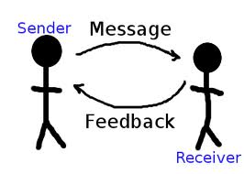
Creating a Job Search Portfolio

Slide 2
Resumes “Imagine you are the brand instead of the applicant. How do you want to make the recruiter feel when they receive your application? Build the written and aesthetic content of your resume and online presence to match that feeling”

Slide 3
Key Messages
Know yourself- what are your workplace strengths and skills hint: its all about the skills not the job title)
Know your audience- hint: have you searched this industry and industry timelines
Know what matters most hint: what does the job description say?
Format matters

Slide 4
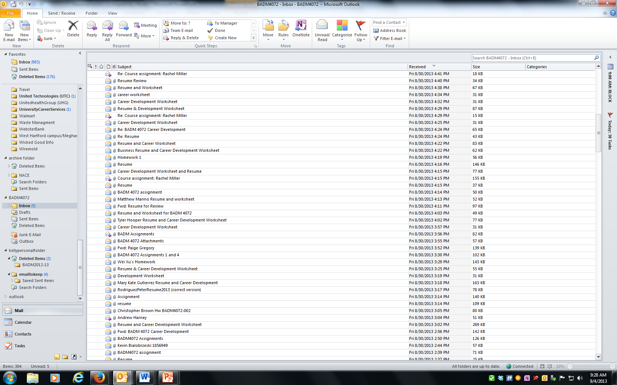
Assignments Stats at a glance… A missed opportunity Received 320 emails with attachments

Slide 5
Assignment Stats at a glance…
The request was to save your resume a certain way: only 96 students did this. Some students had saved the resume under a company name, past year or a first name only.
Only 101 wrote a professional note indicating what you were sending me; addressing me by name (establishing rapport with a salutation is KEY)
Only 166 wrote a description in the RE/SUBJECT section that assisted me in understanding what was in the content of the email.
Only 48 students signed off with a kind comment or pleasantries (The Power of Kindness)

Slide 6
Marketing Yourself- Throughout the process
Moving (ATS) Applicant Tracking Systems
TO Personal Interactions
Every single interaction or communication is
an opportunity to market yourself to the company.
“Hey, professor, here is my resume”
“resume included”
“Is this what you wanted?”
“My resume is in this email”
Here you go!
Resume wouldn’t load
For you!☺

Slide 7
Correspondence Sample
Dear Ms. Flynn,
I recently made an application to the following position of marketing manager #12645. I have attached my resume, for your review. I would like to highlight that my demonstrated analytical skills are a major reason why I am uniquely qualified for this role.
Should you have any questions, please feel to reach me on my cell at 987-657-8888 or by responding to this email address.
Thank you for your time.
Sincerely,
Patricia King
Patricia King

Slide 8
Correspondence Subject Line Examples
1.Use the position title and job number
Example: Data Entry Specialist, ID# 550894 + Your Name
2. Add your most critical skill or professional credential
Example: Nurse Case Manager I – Nancy Luther, RN
3. Include helpful keywords and phrases
Example: Job Application: Linda McCarthy – Editorial Assistant
4. Express your intent and gratitude
Example: Sam Sutherland – Interview Follow-Up & Thank you

Slide 9
Resume Saving!
WEAK
Lastresume.doc
Finalone.doc.
Michelleresume.doc
Mylatestresume.doc
Wonda’sresume.docx
Resumeofficialpages.doc
BEST
(lastnamefirstnameresumeyear)
smithmichelleresume2020.doc
kennedykellyresume2020.doc
kustansaracoverletter2020.pdf

Slide 10
Correspondence begins with intention: In your time vs. their time:
URGENT!! – Respond Immediately
Hey Professor!!!!
I have not heard back from any of the emails I sent you. I am concerned that you are not receiving my emails (including my assignment). Please let me know what is going on.

Slide 11

Target/Relevance - do you have the skills for the job you are applying for?
Expertise - have you anticipated the readers' comments/questions by answering questions about your expertise and skillset in the resume?
Accomplishments - are you bragging about yourself enough? This one makes most of our clients' squirm. It's not easy to do.
Focus - Does your resume have focus? Will a recruiter or hiring manager know what you want to do immediately?
Format - How old is your format? Does it have references-it shouldn’t!

Slide 12
Great résumés should stand out to skim readers
Most recruiters spend just a few seconds skimming through a résumé—with an average in one study of 7.4 seconds.
To have the best chance of making an impression, ensure your job titles, company names and dates of employment are easy to read. Make your résumé robot-friendly.
Structure your résumé to meet the requirements of an applicant tracking system to give yourself the best chance of having it reach an actual human. Optimize keywords. Use the same words and language that are in the job description. For example, three different companies might describe the same role as “programmer,” “developer” or “software engineer.”
Use a straightforward format. Avoid tables and text-based graphics, which might not get picked up by a scan of the résumé. Think about order. When formatting each line item of work experience, list the company name first, followed by the job location (city, state), your job title, and your start and end dates. Some résumés can get lost if the dates are listed before the job title.

Slide 13
Effective Resumes in 2021
Achievements not tasks
Research and Understand how ATS work
Showcase how your actions produced results
Must be clean and easy to read
Use active voice and varied action verbs
Ensure the resume tells a story-
Lead with results in front loaded bullet points

Slide 14

Effective resumes….
Cause the reader to ask good questions
What can this person do for me?
Can this individual help solve my problems?
How can I find out more about this person?

Slide 15
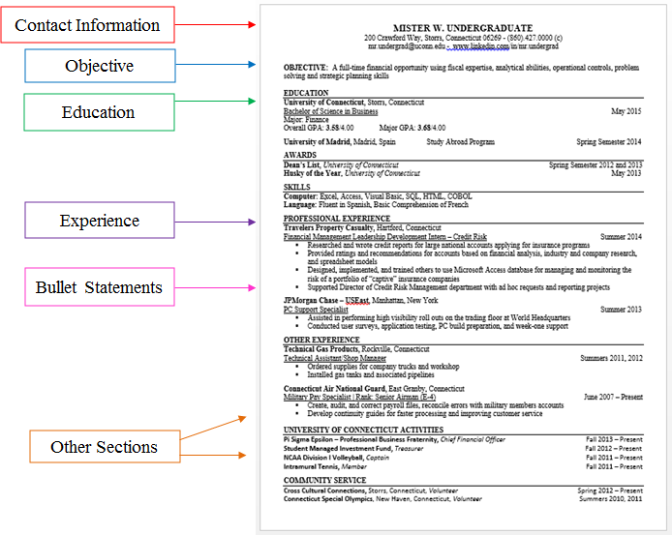
The Final Product

Slide 16
Effective resumes succeed with… The Applicant Tracking System (ATS)
The scan test
The key word test
The qualification test
The job description & industry
Visual
Three top qualification.
1
2
3

Slide 17
An ATS Wants a Specific Match on Keywords
2. Focus on Hard Skills
3. Use their lingo – so CRM software vs. salesforce technology
ATS Truths- Large Companies
Therefore, ATS seeks specific keywords
An ATS primarily looks for hard skills when it scans your resume. For example, commonly used resume keywords and keyword phrases, such as “dynamic,” “team player,” and “self-starter,” are not technical skills, credentials, position titles, and software or tools that are relevant in the industry—because those are the keywords they’ll be checking for.
4. Don’t use Acronyms: UCONN, BA, BS, MBA

Slide 18
Common mistakes…
Header going onto the second page (be cautious of extra "enters")
Using an email address other than their UCONN emails
Not formatting education section correctly - many put "Bachelor of Science in Marketing"
LinkedIn Address was complicated (i.e. JohnSmith_50924t8248)
Bullet statements only stating responsibilities-not doing a great job showing skills or explaining the importance behind what they say
Lots of unnecessary italics and bolding
Dates are not consistent (month and the year the same throughout)
NO narratives on anything– (No feelings “I love traveling”)
Objectives are optional – should only be used when transitioning into another industry

Slide 19
Education
Required Info
Optional Info
Institution
City, State
Graduation Date
Degree
University of Connecticut, Storrs, Connecticut May 2020
Bachelor of Science in Business
Major: ________
Minor: ________
GPA: #.##/4.00, Dean’s List
Major
Minor/ Concentration
Honors or Scholorships
Optional Education Information
Relevant/Related Coursework
Study Abroad Experience
Another College/Associate’s Degree
Thesis Title
Overal or Major GPA

Slide 20
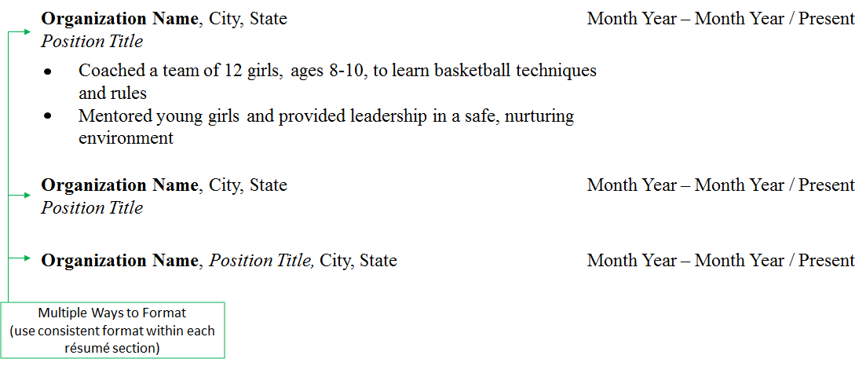
University of Connecticut Leadership

Slide 21
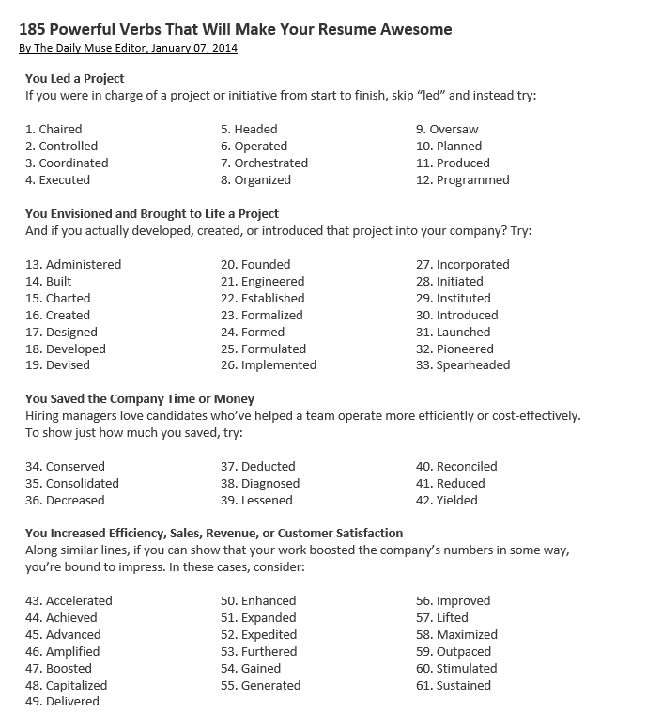
Resume Verb List

Slide 22
Contact Information
Full Name
Mailing Address
Current and/or permanent
First M. Last
1234 Long Hill Road
Mansfield, CT 06226
555.555.5555 (c)
Frist.m.last@uconn.edu
www.linkedin.com/in/Jonathanhusky/
E-mail Address
Phone Number
LinkedIn Public URL

Slide 23
Objective
Do you need an objective?
What if I do not know what I am looking for yet?
What kind of skills should I be listing?
Position Description or Title
Field, Industry or Company
Seeking a _________________ position in ___________ utilizing ______, ______________ and ___________ skills.

Slide 24
Professional Experience
Bullet Statements Describing Tasks & Responsibilities
Position Information
Company Name, City, State Month/Year – Month/Year - Present
Position Title
Addressed customers’ needs and concerns through effective
communication over the phone
Developed a new marketing campaign to better reach target
audience, resulting in a 20% increase
Monitored product inventory using Excel to guarantee adequate
stock and save $1,000 each month on shipping
Action Verbs

Slide 25
Thanks!
Any questions?
You can find me at:
Kelly.kennedy@uconn.edu

